Slide 1
Parallel Counting for the N-Queens Problem
Ben Howard (1905021)
Supervisor – Oliver Kullmann
Presentation – 19/01/2022

Slide 2
Contents
The N-Queens Problem
The Goal
Serial Results
Starting Parallel
In Conclusion

Slide 3
Contents
The N-Queens Problem
The Goal
Serial Results
Starting Parallel
In Conclusion

Slide 4
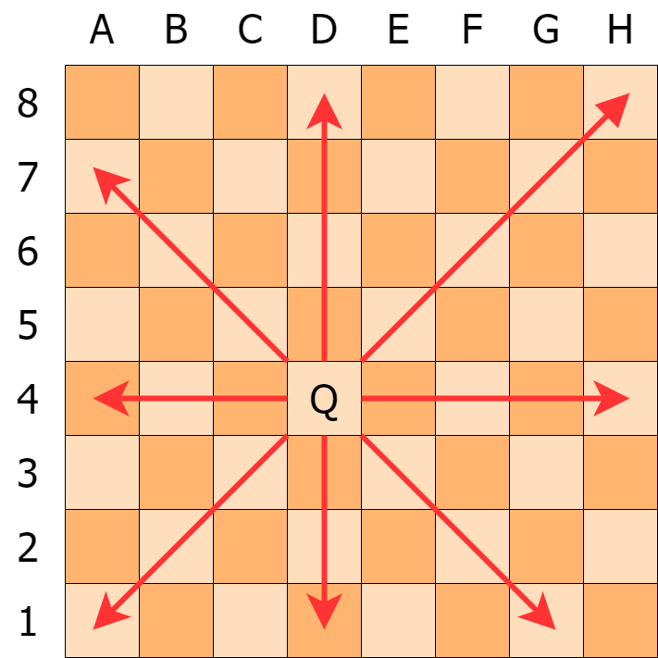
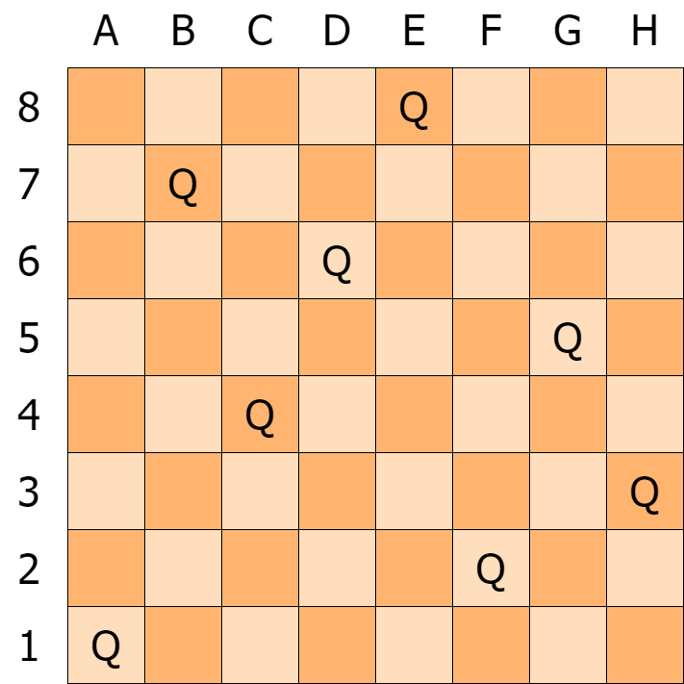
Eight Queens Puzzle

Slide 5
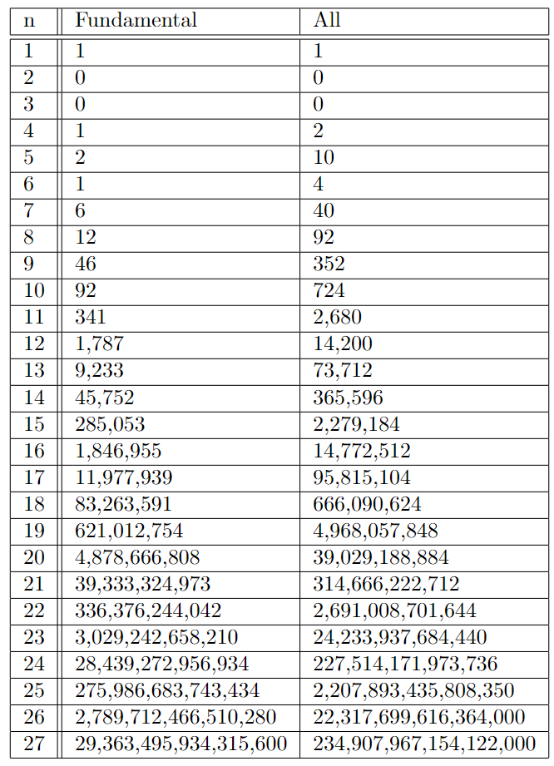
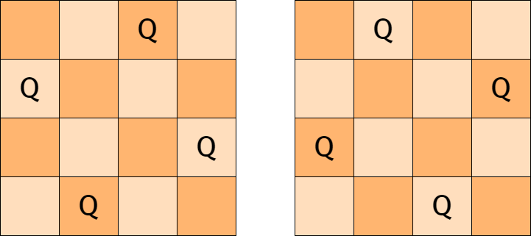
Evolution into N-Queens

Slide 6
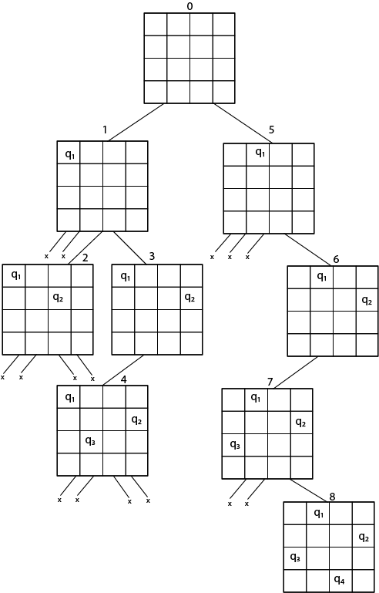
Backtracking Solution

Slide 7
Contents
The N-Queens Problem
The Goal
Serial Results
Starting Parallel
In Conclusion

Slide 8
Aim 1
To implement a parallel N-Queens algorithm on a HPC.

Slide 9
Aim 2
To measure and collect the speed and accuracy of the algorithm.

Slide 10
Aim 3
Use the speed and accuracy data collected to improve and redesign the algorithm.

Slide 11
Aim 4
Summarise my findings and compare the various algorithms implemented.

Slide 12
Aim 5
To correctly calculate the highest value of n I can sensibly achieve

Slide 13
Contents
The N-Queens Problem
The Goal
Serial Results
Starting Parallel
In Conclusion

Slide 14
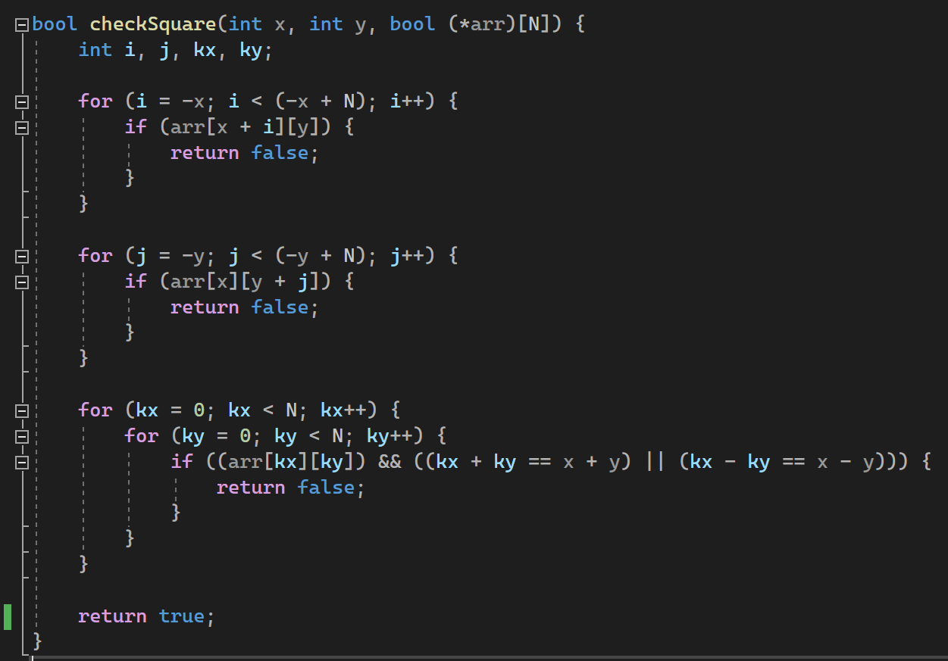
C++
checkSquare function

Slide 15
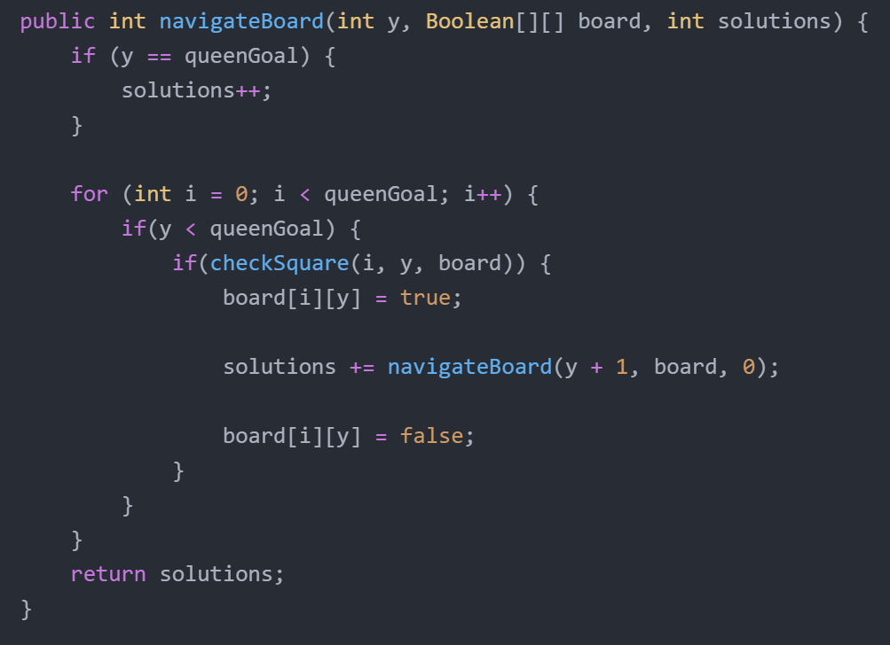
Java
navigateBoard function

Slide 16
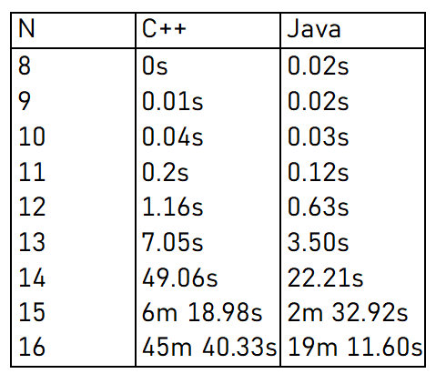
Time to run

Slide 17
Contents
The N-Queens Problem
The Goal
Serial Results
Starting Parallel
In Conclusion

Slide 18
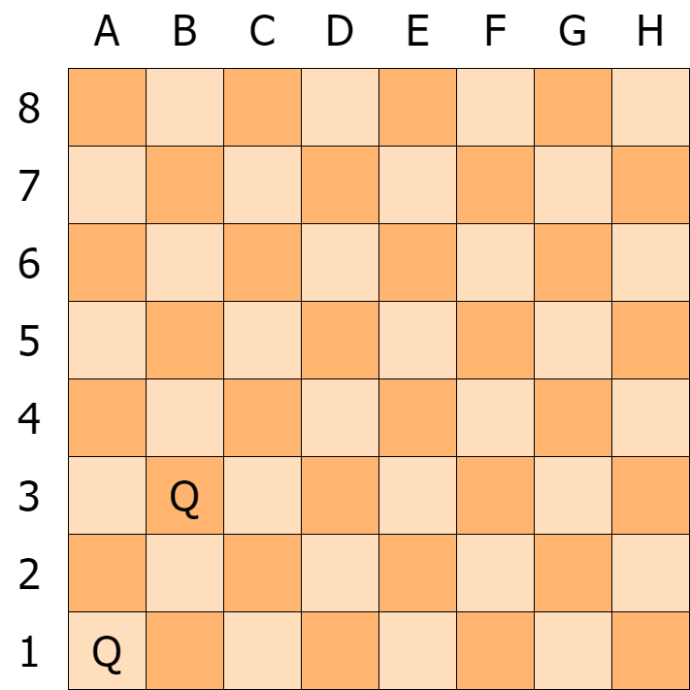
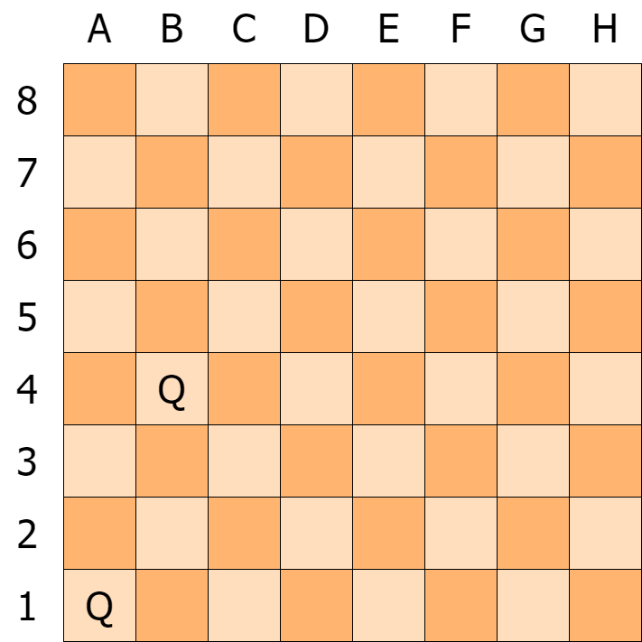
Converting to Parallel

Slide 19
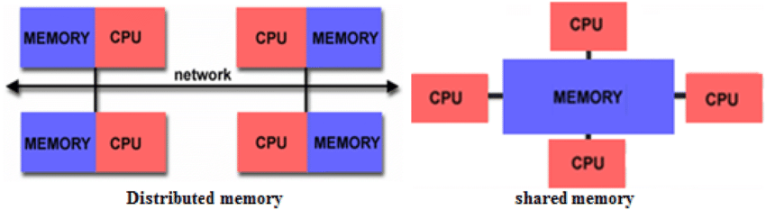
Memory

Slide 20
Contents
The N-Queens Problem
The Goal
Serial Results
Starting Parallel
In Conclusion

Slide 21
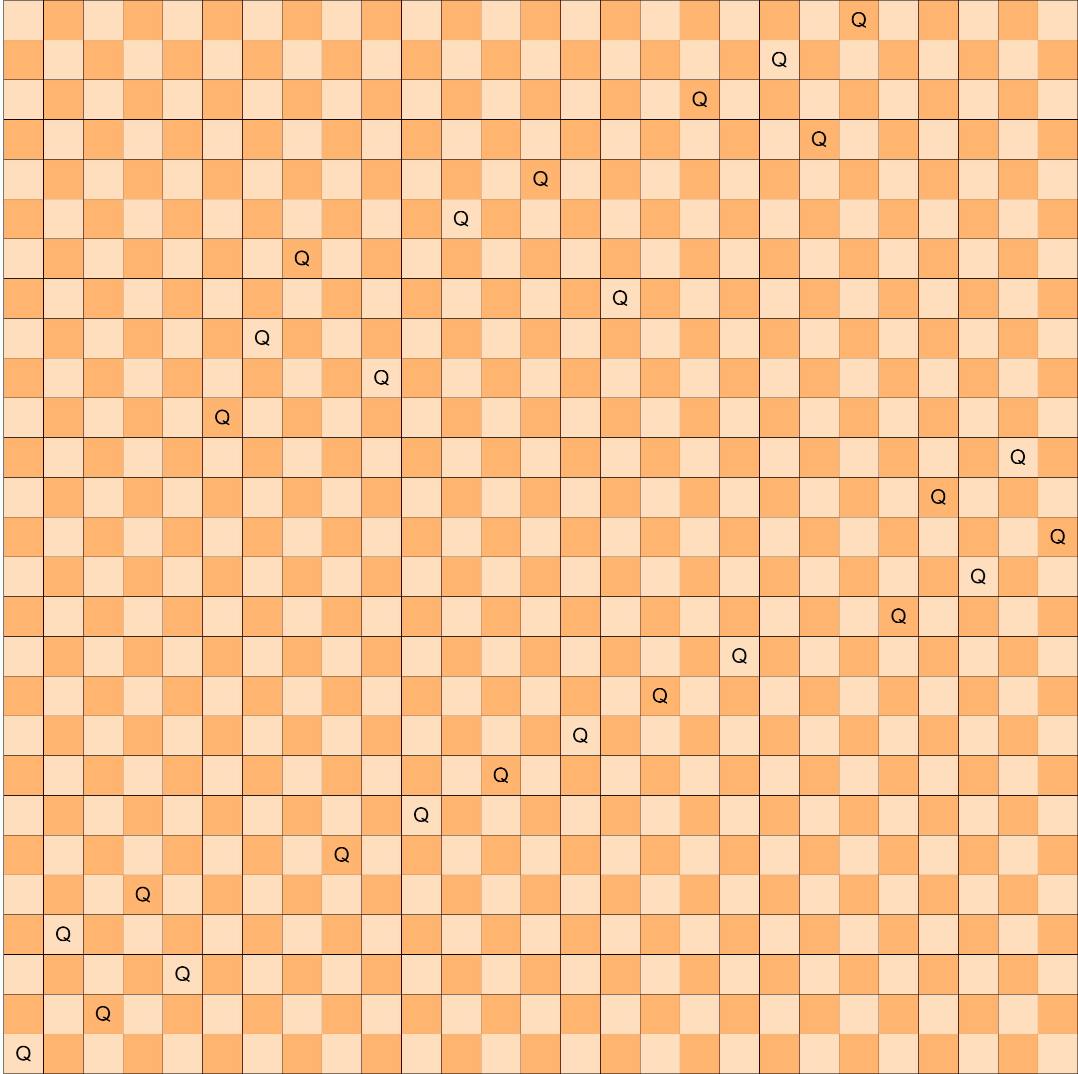
A 27x27 board solution
234,907,967,154,122,000 total solutions

